Slide 1


Slide 2



REUNIFICATION DISCERNMENT
Notes:
Good evening. My name is Drew Dorgan and I am part of the Diocesan Reunification Discernment Committee, representing the Standing Committee of the Diocese of Central Pennsylvania. I am here with my counterpart, Rodney Conn, who is a member of the Diocese of Bethlehem.
The Reunification Discernment Committee is grateful for everyone’s presence today.

Slide 3
A resolution adopted at the 2022 Conventions
of both Dioceses called for
“a period of intentional exploration”
regarding the “future reunification as one diocese.”
Standing Committees appointed a ten member committee
to work with our bishops on this process of discernment.
Notes:
Read resolution as presented on slide

Slide 4
DISCERNMENT COMMITTEE MEMBERS
Diocese of Central PA
Diocese of Bethlehem
The Rt. Rev. Audrey C. Scanlan, Bishop
Ms. Drew Dorgan, SC President
The Rev. John Harwood, Council of Trustees
The Rev. Jim Jenkins, At Large Member
Mr. George Park, At Large Member
Mr. MIchael McAuliffe, Esq. - Chancellor (Vice)
The Ven. Jane Miron, Chaplain
The Rt. Rev. Kevin Nichols, Bishop
The Rev. Douglas Moyer, SC President
The Rev. Sidnie Crawford, Diocesan Council
The Rev. Rodney Conn, At-Large Member, SC
Ms. Ginnie Schoonov, At-Large Member
Mr. Ty Welles, Esq, Asst. Chancellor
The Rev. Chris Sutton, Chaplain
Notes:
We are one Discernment Committee made up of our bishops, the presidents of both Standing Committees, a Council of Trustees/Diocesan Council member, two at-large members from each diocese, the chancellors from our respective diocese, and help from a Chaplain from each Diocese (fun fact…. Our Chaplains, The Ven. Jane Miron and The Rev. Chris Sutton are amazing women completely in sync and keeping us wrapped in prayer). Our outside consultant, The Rev. Jennifer Adams, Rector of Grace Episcopal Church in Holland, Michigan, leads us with grace, wisdom and the experience of unification discernment for two dioceses in Michigan.

Slide 5



THREE POSSIBLE OUTCOMES of this DISCERNMENT
We stay independent
We collaborate in ministry & share resources
We become one
Notes:
We wanted to keep all possibilities open as we move through this work, considering our three possible outcomes at the end of our study. We can remain independent. We may find that we could share some resources. Or we may consider becoming one, reunified diocese.
We want to learn what is the most sustainable, solid platform that can sustain our mission and ministries. How can we be a thriving Episcopal Presence? How can we be better stewards?

Slide 6


PRAYERFULLY
EXPLORE, ANALYZE,
LISTEN, and DESIGN
Phase I: Explore (Gather Data)/Host Listening Sessions
Phase II: Collate and Analyze Data
Phase III: Consider Model & Timeline for Possible Reunification.
Phase IV: Present a Model and Timeline to the Dioceses
Phase V: Prepare Recommendations for Conventions
Notes:
We divided our work into various phases. We are currently asking for additional time as we transition into Phase III that includes modeling and timelines.
We have a brief introduction video from our two bishops.

Slide 7
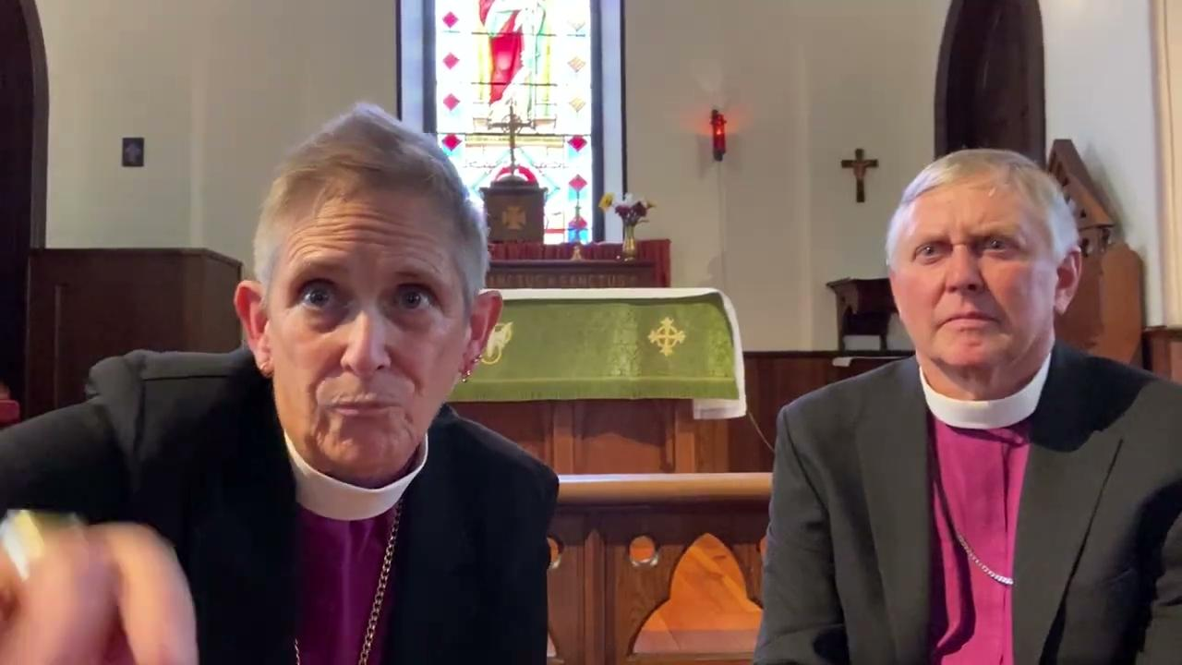

Slide 8
The Episcopal Church
Diocese of Pennsylvania – 1785
Diocese of Pittsburgh – 1866
  Diocese of Northwestern Pennsylvania – 1910
Diocese of Central Pennsylvania – 1870
  Diocese of Central Pennsylvania and Harrisburg – 1904
  Central Pennsylvania adopts Bethlehem name – 1909
  Harrisburg reclaims Central Pennsylvania name – 1971
Notes:
Remind the audience that we are presenting a summary of information and for a complete listing of information, they can refer to the full written report found on the diocesan website.

Slide 9
Today’s Demographics
In 2020, Hispanic residents in Lehigh and Berks counties were 23-25% of the residents.
In Pennsylvania and in most of the state’s counties, the youth population, or those under 18 years of age, was more diverse than adult population, (56.4% vs 40.3% diversity index, respectively).*
*PA State Data Center Report, US Census Bureau, source
Notes:
As referenced on the slide, the Diocese of Bethlehem has seen significant growth in the hispanic population. This growth is also reflected through both dioceses mission work, which we will review later in the presentation.

Slide 10
Some Numbers
Communicants
  1904 – two dioceses totaled 18,918
  1925 – Bp. Talbot retirement: had grown to 29,898 (58% growth in two decades)
  2021 – two dioceses total 17,254
We are smaller now than when we split nearly 120 years ago
Notes:
Present the slide with reference to the decline in communicants from 1904 to current day.

Slide 11
Other Episcopal Dioceses & Reunification
Duluth and Minnesota reunified - 1944
Chicago and Quincy reunified in - 2013
Texas and Fort Worth reunified - 2022
The three dioceses of Wisconsin voting on reunification - October 2023
Eastern Michigan and Western Michigan voting on juncture - March 2024
Northeast Pennsylvania and Western New York sharing a bishop
Dioceses of Northern Indiana and Indianapolis are in discernment
Maine-Vermont-New Hampshire: bishops are diocesan in their home diocese and serving as assisting bishops in the other two while the dioceses discern ways forward
Notes:
Refer the dioceses that have already completed unification/reunification, as well as those currently going through the review process.

Slide 12

Diocese | Parishes | Sq Miles | Year Formed
Montana | 34 | 147040 | 1904
Arizona | 80 | 113990 | 1959
Nevada | 34 | 110572 | 1970
Colorado | 93 | 104094 | 1887
Wyoming | 44 | 97813 | 1968
Minnesota | 111 | 86936 | 1857
Nebraska | 52 | 77358 | 1868
West Virginia | 60 | 24260 | 1878
Notes:
One of the concerns people have voiced is that if were to reunify, the new diocese would be “too big” geographically for us to function well. A reunified diocese here would be about 24,000 sq miles. This represents 1/5 the size of the state of Colorado, which has the added challenge presented by the Rocky Mountains, and comparable in size to West Virginia.

Slide 13
Quiet Reflection
“Do not be conformed to this world, but be transformed by the renewal of your mind, that by testing you may discern what is the will of God, what is good and acceptable and perfect.”
(Romans 12:2)
Notes:
Good morning, My name is Jane Miron, one of two chaplains for the Reunification Discernment Committee. Chris Sutton couldn’t be with us today. This is the first of three quiet reflections that I will lead you through. You will find printed cards at each of your seats with scripture that inspired us as we progressed over these past months. I would invite each of you to write a prayer on the back for sharing with the Diocese of Bethlehem, or you are invited to take them home with you. If you would like to share a prayer, we will gather them at the end of the presentation.

Slide 14
Stewardship of Resources:
Organization, Governance, & Finance
Notes:
Remind the audience that we are presenting a summary of information and for a complete listing of information, they can refer to the full written report found on the diocesan website.

Slide 15
WHAT WE ARE PRESENTING TODAY
Basic Diocesan Statistics
A Financial Picture of Each Diocese
Diocesan Staffing Configurations
Some Patterns and Trends
Notes:
Review points for presentation.

Slide 16
WHAT WE WILL STUDY NEXT PHASE
Diocesan Constitution & Canons
Governance Structures
Fair Share
Models, Budget & Timelines for possible reunification.
Notes:
Remind audience of what we won’t be covering today and will part of the next phases in our process.

Slide 17
GEOGRAPHY & POPULATION
Diocese of Bethlehem
14 counties
Population – 2,465,678
Area – 7,834 square miles
Ten counties with pop > 150,000
Four counties with pop < 100,000
Diocese of Central PA
24 counties
Population -2,609,628
Area – 16,902 sq miles
Six counties with pop > 150,000
Ten counties with pop < 100,000
Notes:
Review of information with emphasis on similarities.

Slide 18
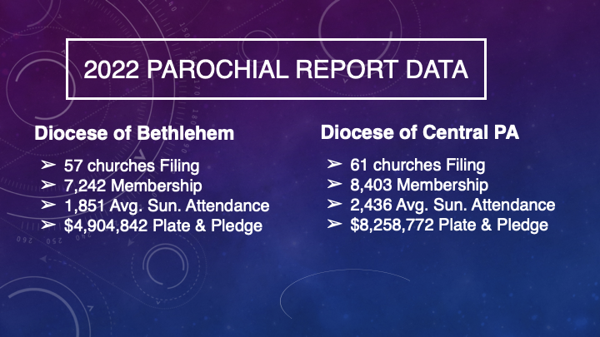
2022 PAROCHIAL REPORT DATA
Notes:
Review of information with emphasis on similarities.

Slide 19
STAFF
DIOCESE OF BETHLEHEM
Total: 7.125 FTE
Bishop (1)
Chief Operating Officer (1)
Canon for Racial Reconciliation and Community Engagement (1)
Northern Canon Missioner & Assistant (1)
Southern Canon Missioner & Assistant (1)
Bookkeeper (1)
Missioner for Finance & Administration (1)
Safe-guarding/Communications Consultant (Contractor) (.125)
Notes:
Review Staff complement.

Slide 20
STAFF
DIOCESE OF CENTRAL PENNSYLVANIA
Total: 8.5 FTE
Bishop (1)
Canon for Finance and Operations (1), Bookkeeper (.5)
Canon for Communications and Events (1)
Communications Assistant (.40)
Executive Assistant to the Bishop (.75)/Assistant for Events (.25)
Canon for Children Youth & Families and Safeguarding Administrator (.75)
Associate for Congregational VItality & SBF and Interim Transition Officer (.75)
Dean of Stevenson School for Ministry (1), Associate Dean SSFM (.25)
Archivist, Receptionist, HR Administrator (.5), Property Manager (.40)
Notes:
Review Staff information.

Slide 21
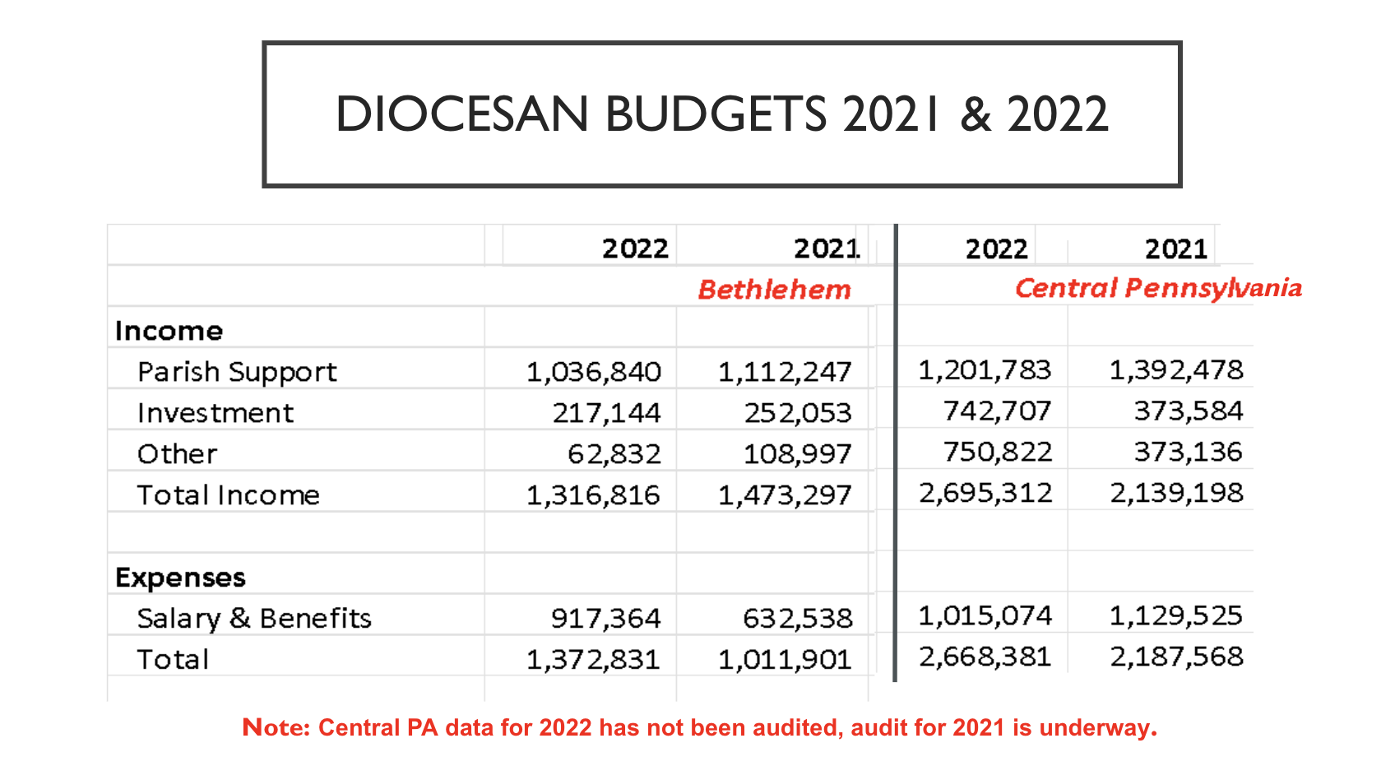
DIOCESAN BUDGETS 2021 & 2022
Review information.
Notes:
Review slide information.

Slide 22
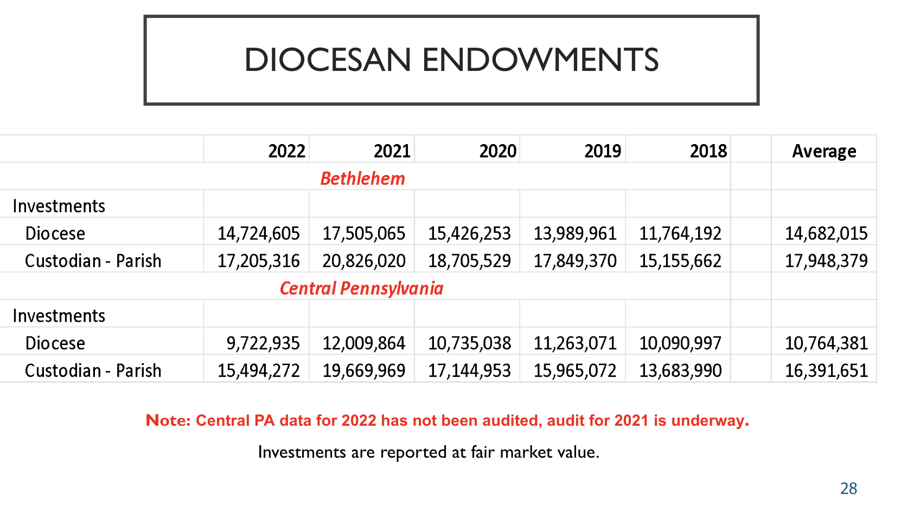
DIOCESAN ENDOWMENTS
Notes:
Review information.

Slide 23
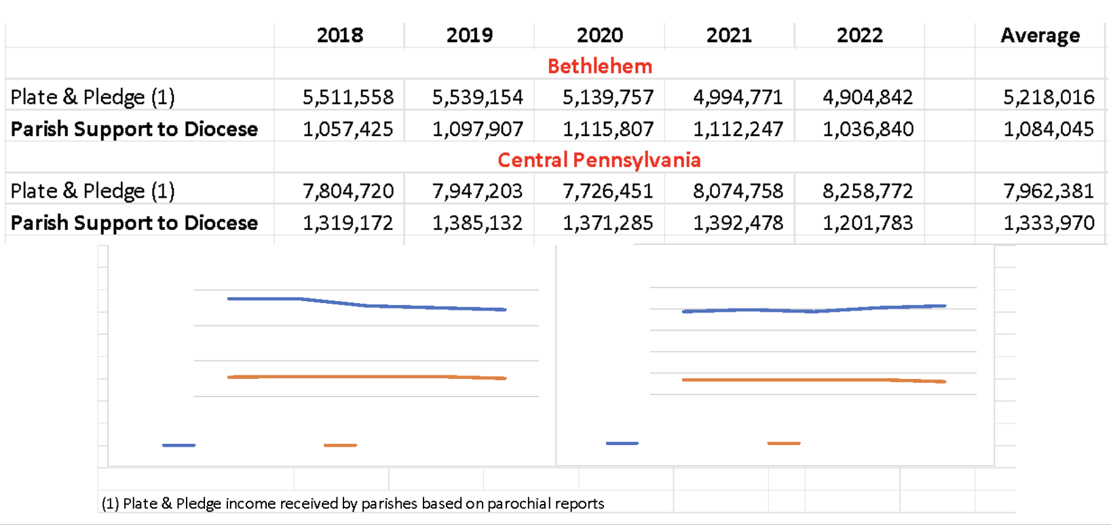
FAIR SHARE & TRENDS
Blue = pledge and plate, Orange = Parish Support to Diocese
Notes:
Review information.

Slide 24
LOANS/INDEBTEDNESS
Neither Diocese reports any significant indebtedness other than funds held
on behalf of the parishes.
Notes:
Review slide information.

Slide 25
PATTERNS & TRENDS
  Both dioceses are very similar in terms of membership, number of parishes, staffing and financial resources.
  There is a similar mix of rural and urban churches.
  The most significant difference is geographic size with Central Pennsylvania being nearly twice as large.
  The staffs are similar in size, but organized differently. Bethlehem has a more decentralized model. Central PA uses a more centralized approach and also includes staffing for the Stevenson School.
Notes:
Review slide information.

Slide 26
PATTERNS & TRENDS
  In the most recent Parochial Data Report, both dioceses had a significant decrease in Average Sunday Attendance (ASA) in the past ten years. Bethlehem’s was 48.5% (3,594 to 1,851) and Central PA’s was 46.3% (4,536 to 2,436). This is slightly higher than for the Episcopal Church overall which decreased 43.2%.
Financial resources for the two dioceses are similar. As of 12/31/22, Bethlehem had $14.7 million in investments and held an additional $17.2 million for its parishes. Central Pennsylvania had $9.7 million in investments and held an additional $15.5 million for its parishes.
Notes:
Review slide information.

Slide 27
Called to Respond
Both Dioceses are responding to the reality of declining numbers, actively addressing the call to steward our resources, and innovating ways to support vibrant ministry throughout our regions.
The Diocese of Bethlehem introduced a reconfigured Convocation and Assembly model that fostered a decentralized approach to leadership and recently implemented a Canon Missioner model to foster care and collaboration among church leaders and congregations. They also recently launched two new Latinx congregations in Bethlehem and Allentown.
The Diocese of Central PA introduced “Shaped by Faith,” a three-part initiative to create a Diocese best shaped to serve God’s mission. Church leaders are given new tools and new ways to help congregations relate to their community, understand their resources, and create sustainable ways of being church.
Notes:
Emphasize declining numbers and call to steward resources.

Slide 28
Quiet Reflection
“As each has received a gift,
use it to serve one another, as good stewards of God's varied grace.”
(I Peter 4:10)
Notes:
Jane to present.

Slide 29


Congregational Ministries Survey
Responses from Parishes
27 Bethlehem & 38 Central PA
Summer Listening Sessions
Five sessions in June & July
About 200 participants from across both dioceses.
Notes:
Remind the audience that we are presenting a summary of information and for a complete listing of information, they can refer to the full written report found on the diocesan website.
Good morning, my name is George Park. Along with the Reverend Dr. Sidnie Crawford and Ms. Drew Dorgan, I am a member of the programmatic sub-team, evaluating the ministries and various programs within the two dioceses. With that in mind we initiated a Spring survey, focused on ministries and followed that with summer listening sessions, as part of the full committee. We were pleased to receive 106 responses to the survey and 200 participants in the summer listening sessions. The survey and listening sessions results display an amazing level of work and engagement across the two dioceses. Each of you should be applauded for your hard work.

Slide 30

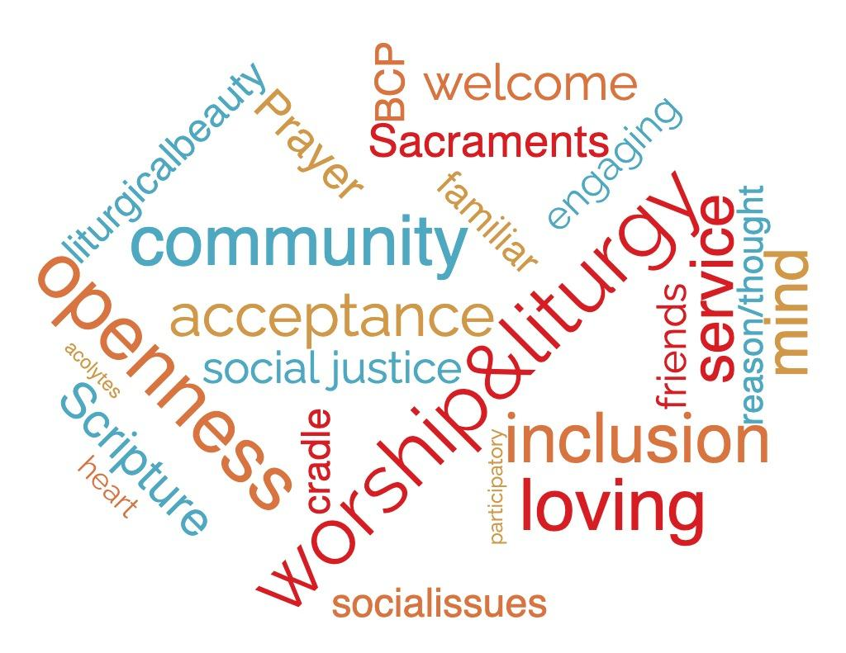
WE ARE EPISCOPALIANS
Notes:
In the Listening Sessions the primary responses to questions around Why you became an Episcopalian and why you remain in our church were: Worship & Liturgy (including the sacraments, the presence and reflection on Scripture, the Book of Common Prayer, the beauty of liturgical experiences). There is a high value on being a “thinking AND thoughtful church,” community service and engagement, and on our work for social justice.

Slide 31
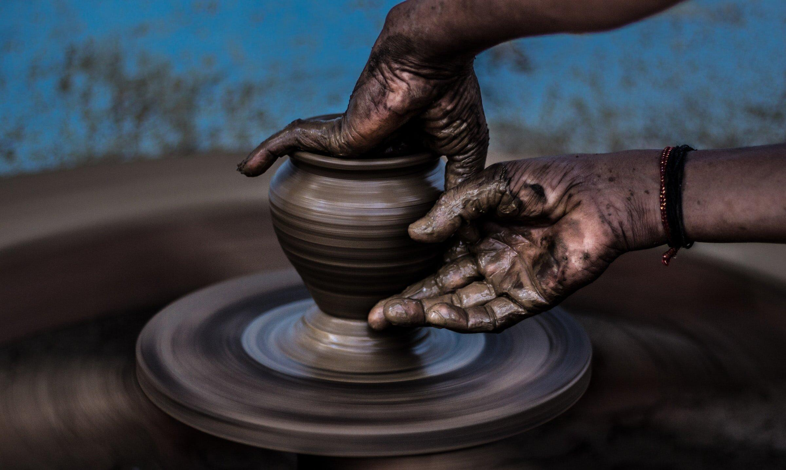
FORMATION IS
A STRENGTH OF BOTH DIOCESES
Notes:
The survey revealed strong parish-level formation programs in both dioceses. Formation, worship and liturgy propel us toward mission work. Let’s talk about a few of the Diocesan-level formation opportunities.

Slide 32
THE STEVENSON
SCHOOL for MINISTRY
The Stevenson School for Ministry in Central PA provides theological education for all Episcopalians wanting to explore and prepare for their lifelong learning and vocational call.
Notes:
The Stevenson School for Ministry’s mission was founded around serving the Diocese of Central Pennsylvania. Since its inception, the Stevenson School has grown beyond that original mission, providing services for other dioceses. This is a key area of collaboration, with the Diocese of Bethlehem sending some of their postulants and candidates to courses at the Stevenson School.

Slide 33


GATHER
Gather is The Diocese
of Bethlehem’s annual spring formation
event for lay and
clergy leaders.
Notes:
With prayer, worship, and invaluable courses, Gather helps people in The Diocese of Bethlehem grow lay leaders and spiritual maturity. It is an opportunity to bring wider church speakers to present on priorities that match the wider church priorities. The Diocese of Central Pennsylvania was invited to share in this event in the spring of 2024.

Slide 34


OUTREACH AND SOCIAL JUSTICE are PRIORITIES
IN BOTH DIOCESES
Notes:
Outreach and Social Justice ministries maintain a strong presence in both Dioceses. Let’s review several programs.

Slide 35

RACIAL JUSTICE
Both dioceses and their parishes are dedicated to addressing systemic racism and fostering the creation of Beloved Community in the church and society.
Notes:
The Diocese of Bethlehem’s Racial Justice and Reconciliation Task Force and the Diocese of Central Pennsylvania’s Dismantling Racism Commission are charged with creating a clear, compassionate, operational and effective strategy for dismantling systemic and institutional racism in our two dioceses.

Slide 36
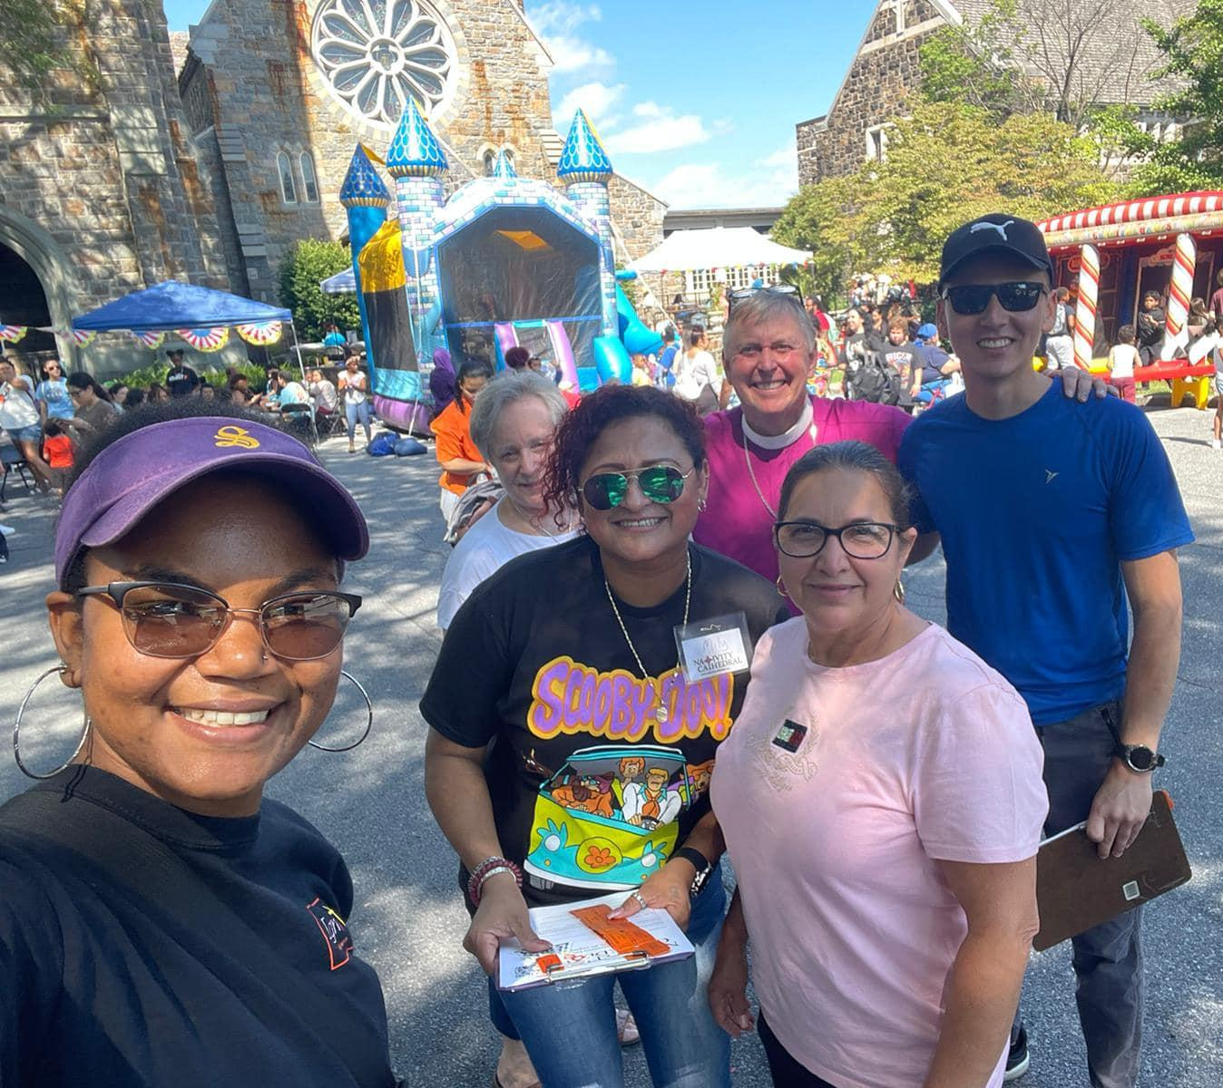
Ministerios Latinx
The Diocese of Bethlehem launched two Latinx congregations, Parroquia Catedral de la Natividad
(Cathedral Church of the Nativity) in Bethlehem and
La Iglesia de Cristo el Mediador (Church of the Mediator) in Allentown.
Notes:
As mentioned earlier, in order to meet the needs of its growing Latino/LatinX population, the Diocese of Bethlehem launched two LatinX congregations, located in Bethlehem and Allentown.
When we speak of outreach, the Diocese’s global partnership with the Diocese of Kajo Keji (KaJoe KayGee), in South Sudan, is another key part of ministry. Imagine if these diocesan-level groups could share resources and experiences. How might that reshape and expand those efforts?

Slide 37
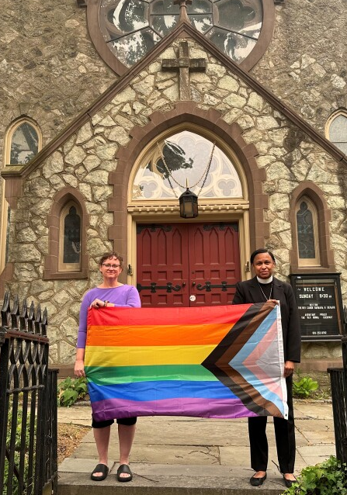
LGBTQIA+ MINISTRIES
Both dioceses and their parishes are committed to LGBTQIA+ inclusion and justice efforts and participate in PRIDE celebrations across the region. The Diocese of Bethlehem recently opened The LGBT Center of Greater Reading.
Notes:
The LGBT Center of Greater Reading opened a Lebanon satellite location at St. Luke’s Episcopal Church in Lebanon City. The new location is offering a variety of LGBTQIA+ affirming counseling and therapy services for individuals, couples, families, and small groups. These services are offered at low or no cost to clients.
Imagine if we could network to understand what was needed to create this new location and get it up and running. Would your community benefit from those services?

Slide 38
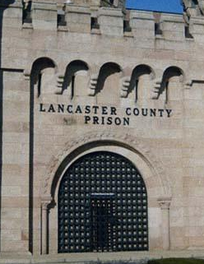
PRISON MINISTRY
The Diocese of Central PA has an active
prison ministry. Laity and clergy are visitors and penpals with people who are incarcerated in local prisons.
Notes:
Clergy and lay people are participating at both the local and federal prison level in the Prison Ministry, calling each of us into a relationship with Christ the Prisoner. Imagine if we could expand this ministry to all the prisons in our two dioceses?

Slide 39
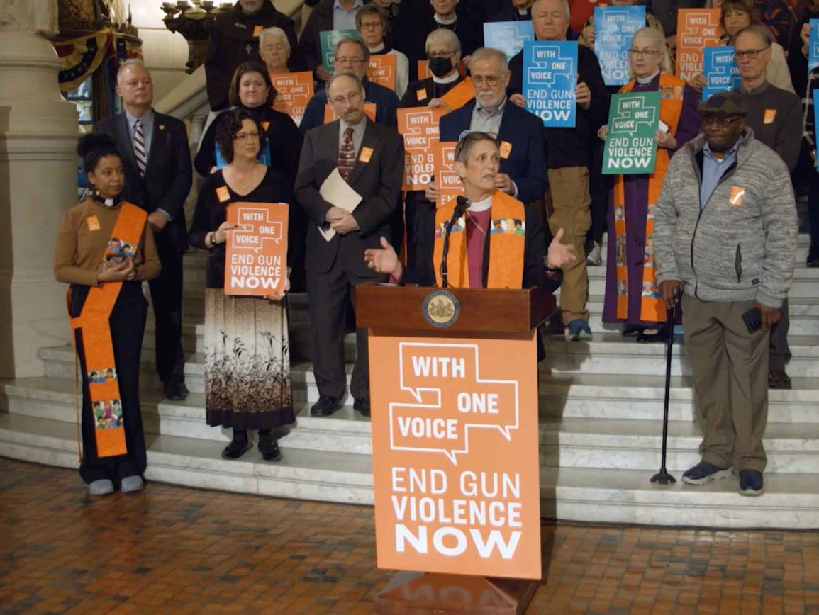
SAVING LIVES: ENDING GUN VIOLENCE
Bishops Scanlan and Nichols and members of both dioceses are involved in church and state-wide initiatives against gun violence.
Notes:
The bishops from both dioceses are active in the Bishops Against Gun Violence initiative. Bishop Scanlan, having a strong presence in the movement, has scheduled a statewide rally day on November 15th. Anti-Gun Violence was also identified as a diocesan-wide program for both dioceses in the spring survey.

Slide 40

FEEDING & SHELTER MINISTRIES
Feeding and/or shelter ministries are
a top priority in nearly every parish reporting in the survey.
Notes:
Everyone in this room who has been involved with or supported a feeding or shelter ministry, please stand.
In a world of growing shelter and food insecurities, it certainly does look like we are listening to Jesus’s call to feed the hungry.

Slide 41
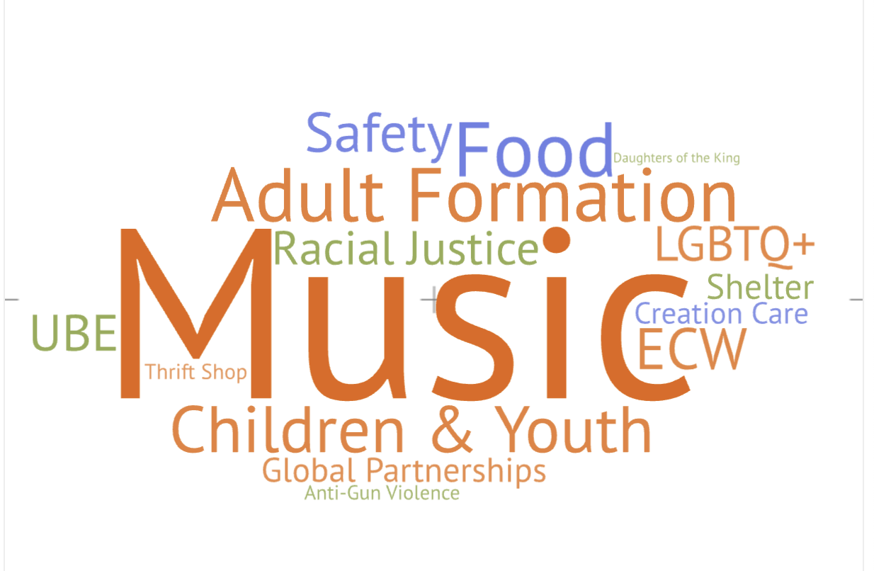
Ministries with Highest Involvement from Survey
Notes:
This word cloud shows that Music, Adult Formation, Children & Youth and Food ministries yielded the highest survey results with involvement in congregation and community for both participation and resource support.
We know how hard it is to fill out committees and gather enough volunteers to do this valuable work, but it is being done. What ministries might benefit even more through collaborative committees and shared resources?

Slide 42
ADDITIONAL PARISH MINISTRIES & PARTNERSHIPS
  AA and NA Support
  Chamber of Commerce Involvement
  Community Sponsored Events
  Community Blood Banks
  Community Food Banks
  Community Garden
  Cheyenne River Mission
  Church World Services
  Diaper Banks
  Grant Programs
  Habitat for Humanity
  Meals on Wheels
  NAACP
  Nursing Home Support
  Outdoor Food Blessing Boxes
  Pilgrimage & Mission Work
  Prison Ministries
  Relief Programs
  Shelter Programs
  St. Stephens Episcopal School
  UCC Participation
  YWCA
Notes:
This slide, while not all inclusive, shows the many other programs being supported at the individual parish level across the two dioceses. The wealth and depth of ministries and partnerships within the diocese are NOT declining.

Slide 43
Quiet Reflection
“Now to him who by the power at work within us is able to accomplish infinitely more than we can ask or imagine, to God be glory
in the church and in Christ Jesus
to all generations, for ever and ever.”
(Romans 3:20-21)
Notes:
Jane to present.

Slide 44
NEXT STEPS FOR THIS COMMITTEE
Continue to analyze data and feedback
Focus on feedback and areas brought forward for greater attention
Consider models for further collaboration and possible reunification
Remain in conversation with other dioceses in discernment
Continue to engage and seek input from across our dioceses
Prepare recommendations for the 2024 Diocesan Conventions
Notes:
Read slide and remind the audience that we are presenting a summary of information and for a complete listing of information, they can refer to the full written report found on the diocesan website.

Slide 45
2023 RESOLUTION
Extends the period of intentional exploration of the future reunification
Continues the work of the appointed Reunification Discernment Committee as charged
Authorizes the bishops to continue engagement of the consultant
Includes both diocese contributing an equal amount to the process, with neither contributing more than $25,000 between the 2023 & 2024 Diocesan Conventions
Continues the Committee’s charge to report its findings quarterly to each Standing Committee, to seek input from and address questions raised by members of both dioceses, and to prepare recommendations regarding reunification to be made at Conventions in Fall 2024
Notes:
Read the resolution to remind everyone that we are recommending a longer timeframe in which to continue this work.

Slide 46
TABLE QUESTIONS
What are your reactions to this presentation?
What positive outcomes do you see as a result of this shared discernment process?
What would you like this Committee to explore as they continue?
Notes:
On behalf of the entire committee, thank you for listening to today’s presentation. We also want to hear from you. What are your reactions to this presentation? What positive outcomes do you see as a result of this process? What would you like this committee to explore as we continue? There are tablets and pens at each table. We ask that one person act as speaker and one person act as scribe. We’ll take about 20 minutes and the move to the feedback portion. Thank you.

Slide 47


